Slide 1
Q&A for OPPO smartphone users:
Question |  | Page.
Q1 | A smartphone cannot receive a call with PUSH is ON. | 2

Slide 2
Q1 | A smartphone cannot receive a call with PUSH is ON.
A1 | After changing the following settings, please try if Push Notification works : Allow Notification feature. Change the Energy Saver setting. Lock app on the Recent Screen. Allow Startup in background status. (need restart) For details, see next page. *These steps are explained using the screen of OPPO R11s (Color OS 3.2 / Android 7.1.1). Note: even if it done, a smartphone cannot receive a call with push notification when MobileSoftphone app is killed.

Slide 3
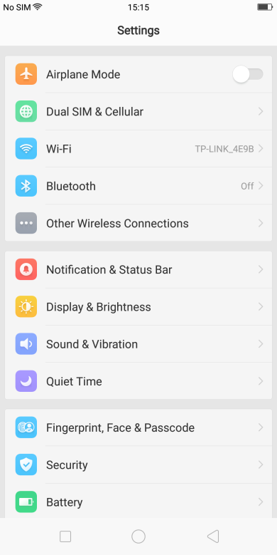
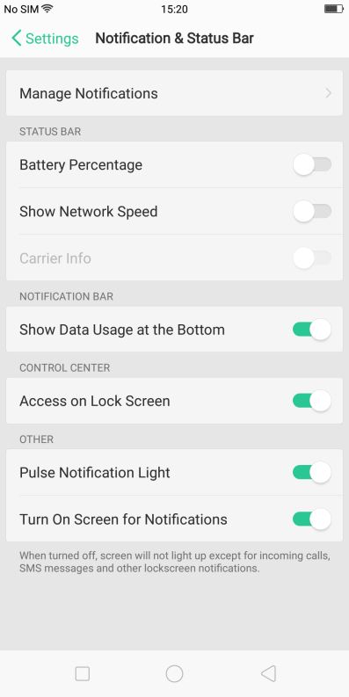
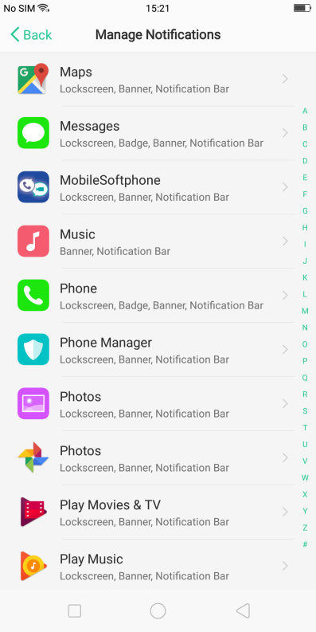
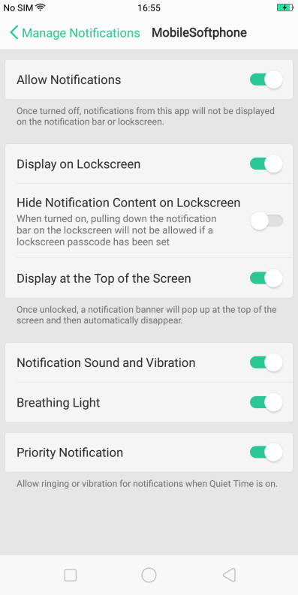
1. Allow Notification feature
On the Settings screen:
Select Notification Panel & Status Bar
Select Notification center
Select MobileSoftphone icon
Activate “Allow Notifications” and also “Priority display”.
3

Slide 4
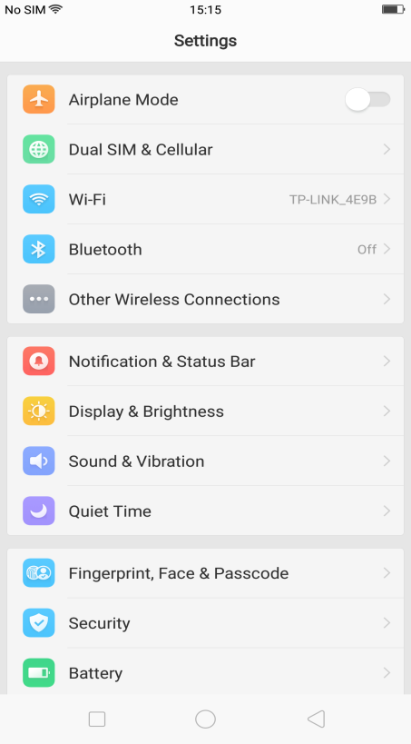
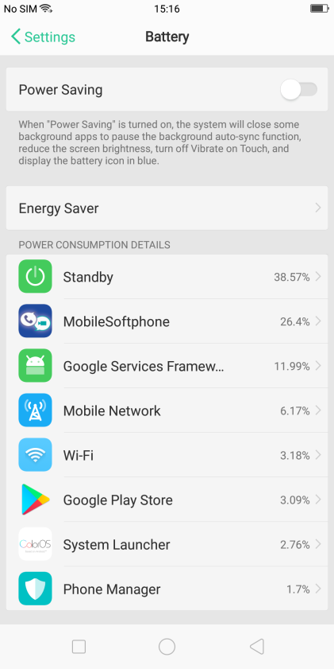
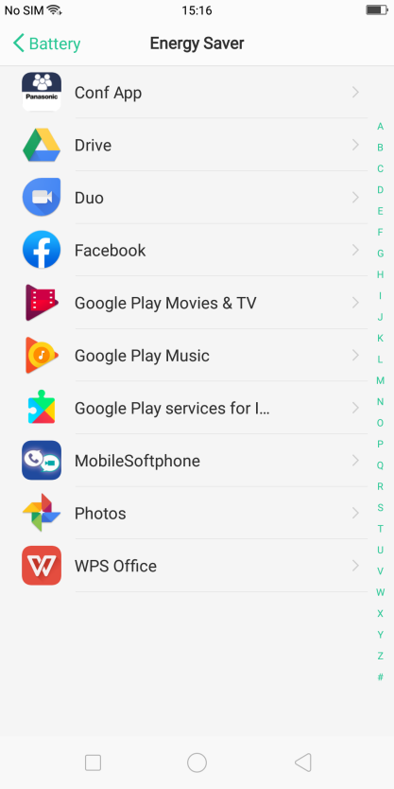
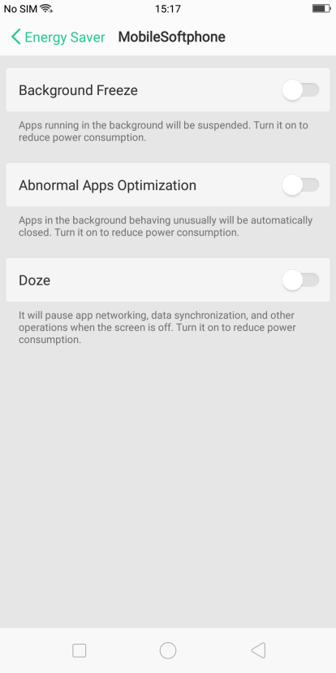
2. Change the Energy Saver setting
On the Settings screen:
Select Battery
Select Energy Saver
Select MobileSoftphone icon
Switch off “Background Freeze”, “Abnormal Apps Optimization” and “Doze”.

Slide 5
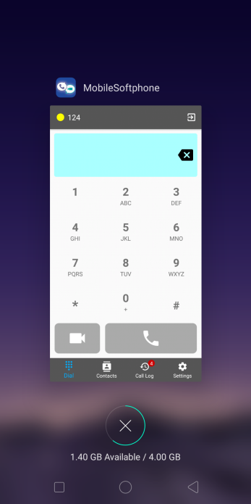
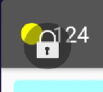
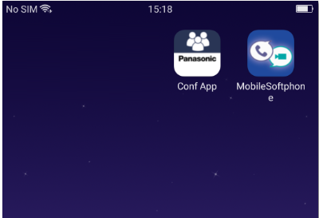
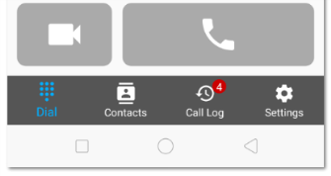
3. Lock app on the Resents Screen
On the Home screen:
Launch “MobileSoftphone” app
Go to Recent screen (Tap the left button on the bottom of your smartphone)
Swipe down on “MobileSoftphone” screen
Confirm the lock mark is displayed on “MobileSoftphone” screen

Slide 6
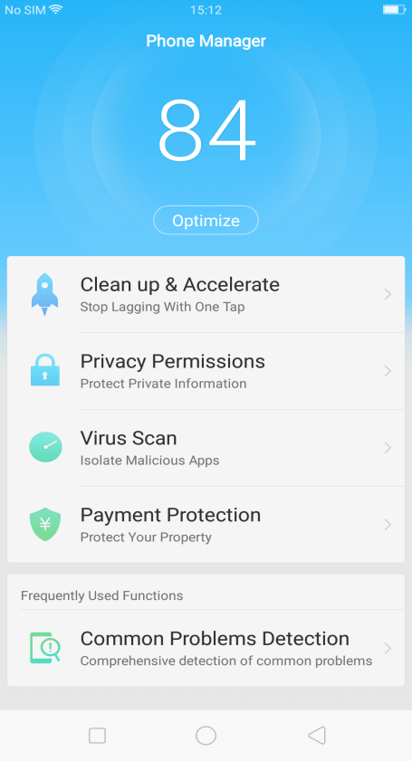
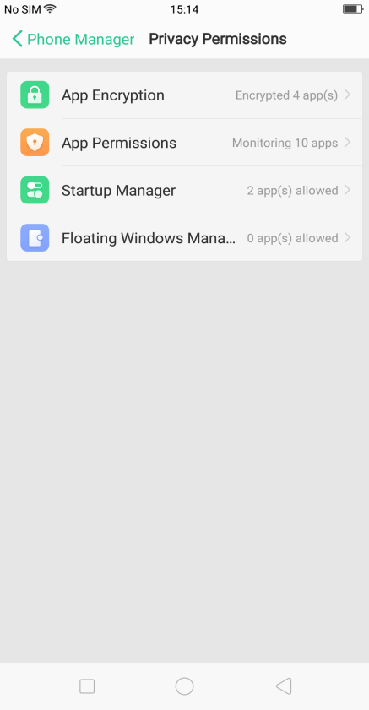
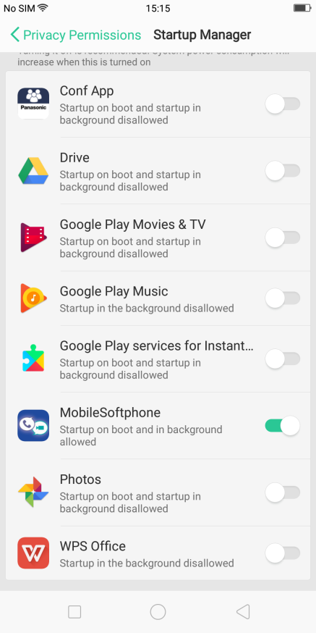
4. Allow Startup in background status.
On the Phone Manager screen:
Select Privacy Permissions
Select Startup Manager
Activate startup selection for “MobileSoftphone” app
To effect the change of setting, Restart the phone (Color OS).

